Slide 1
Digital Portfolio
STUDENT NAME:M.VINOTHINI
REGISTER NO AND NMID:24134031802522056
DEPARTMENT: B.SC.COMPUTER SCIENCE
COLLEGE: PS.PT.MGR GOVT & SCIENCE COLLEGE PUTHUR,SIRKALI/

Slide 2
PROJECT TITLE
Cybersecurity projects

Slide 3


AGENDA
Problem Statement
Project Overview
End Users
Tools and Technologies
Portfolio design and Layout
Features and Functionality
Results and Screenshots
Conclusion
Github Link
3/21/2024 Annual Review

Slide 4

PROBLEM STATEMENT
Organization face phishing attacks leading to data breaches.
There is a need for a machine –learning-based phishing detection
System.

Slide 5

PROJECT OVERVIEW
This project builds a phishing URL delection model that classifies links as
Malicious or safe using supervised learning techniques.

Slide 6
WHO ARE THE END USERS?
Who benefits from this project?
Companies (IT security teams)
Individual internet users
Security researchers

Slide 7

TOOLS AND TECHNIQUES
Programming languages:Python,Java,etc.
Frameworks: TensorFlow,Scikit-learn
Tools:Wireshark,Metasploit,Kali Linux
Databases:MongoDB,MySQL

Slide 8
PORTFOLIO DESIGN AND LAYOUT
Structure of your portfolio/project:
Homepage(Overview of project)
Dashboards(Results,graphs,threat analysis)
Code(linked via GitHub)
8

Slide 9
FEATURES AND FUNCTIONALITY
Real-time phishing detection
Threat alerts and logs
User authentication and role management
Visualization of attack attempts

Slide 10

RESULTS AND SCREENSHOTS
Include performance metrics (Accuracy, Precision, Recall, F1 Score)
Graphs showing detection success rates
Screenshots of dashboards, terminal, outputs or GUI
3/21/2024 Annual Review
10

Slide 11
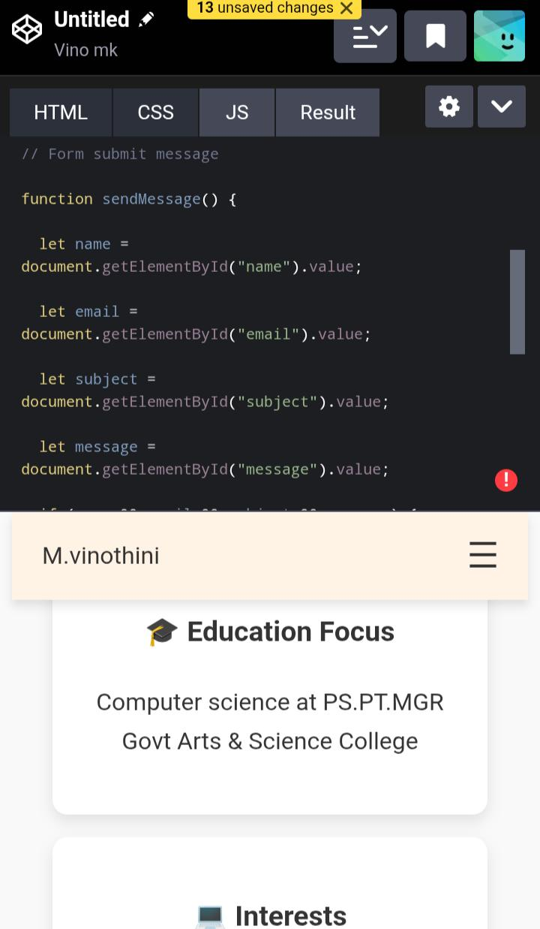
Screen shot

Slide 12
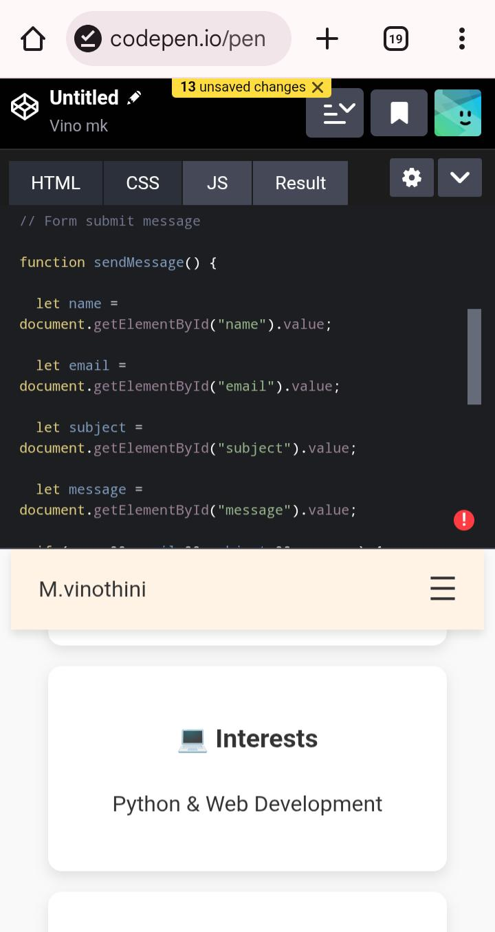
Screen shot

Slide 13
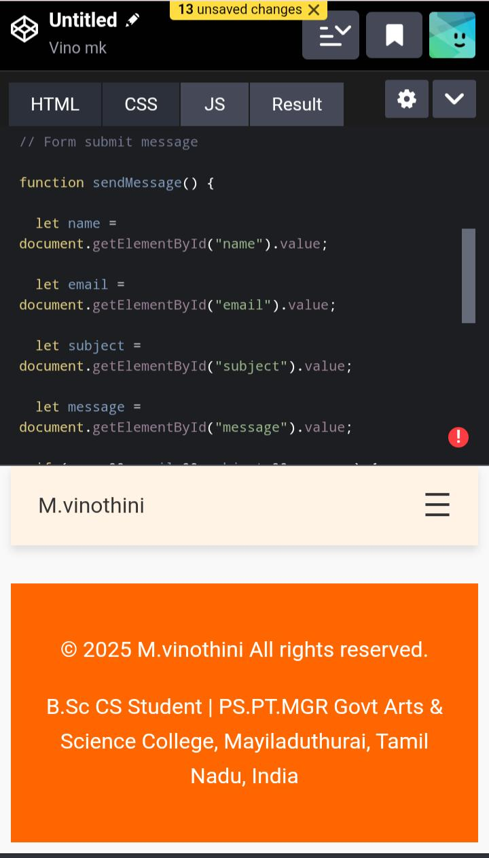
Screen shot

Slide 14
Conclusion
Summarize project impact
Example:
“The systems detects Phishing URLs with 95% accuracy,helping reduce cyber threats and improve user security.”

Slide 15
GitHub link
Add your project repository link(e.g..,https://github.com/your username/cybersecurity –peoject)

